Slide 1

세종대왕
Sejong the Great
Notes:
세종대왕
세종 the great

Slide 2
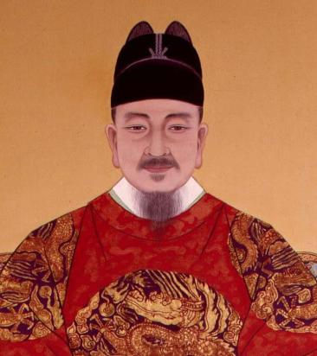
세종대왕
이름: 이 도
조선 제 4대왕
재위기간: 1418년 8월 (22세) – 1450년 2월 (53세)
취미: 공부, 책 읽기
특이 사항: 절대 음감, 토론, 경청
Notes:
세종대왕’s original name was ‘이도’. ‘세종’ was the name given to him by his successor in consideration of all his achievements, and ‘대왕’ means the great king. This title was given to kings for their many achievements. 세종 was the fourth king of 조선. He became king in 1418 at the age of 22 till the age of 53 in 1450. 세종's hobbies were studying and reading books. He was a king who liked to debate and listen. Fun fact, he also had perfect pitch.

Slide 3
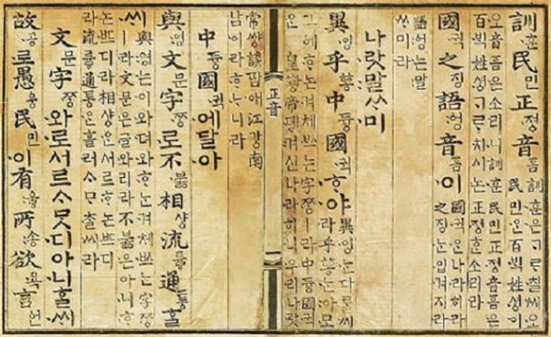
훈민정음
Notes:
Look at this picture, this picture is 훈민 정음. When 한글 was first created, the name was '훈민정음', not '한글'.

Slide 4
훈 민 정 음
백성을 가르치는
바른 소리
애민정신(백성들을 사랑하는 마음)을 가지고 한글을 만들었음
Notes:
‘훈민’ means teaching the people. ‘정음’ means right sound. 훈민정음 means ‘the right sound to teach the people’. The reason 세종대왕 created 한글, was his love for them.

Slide 5
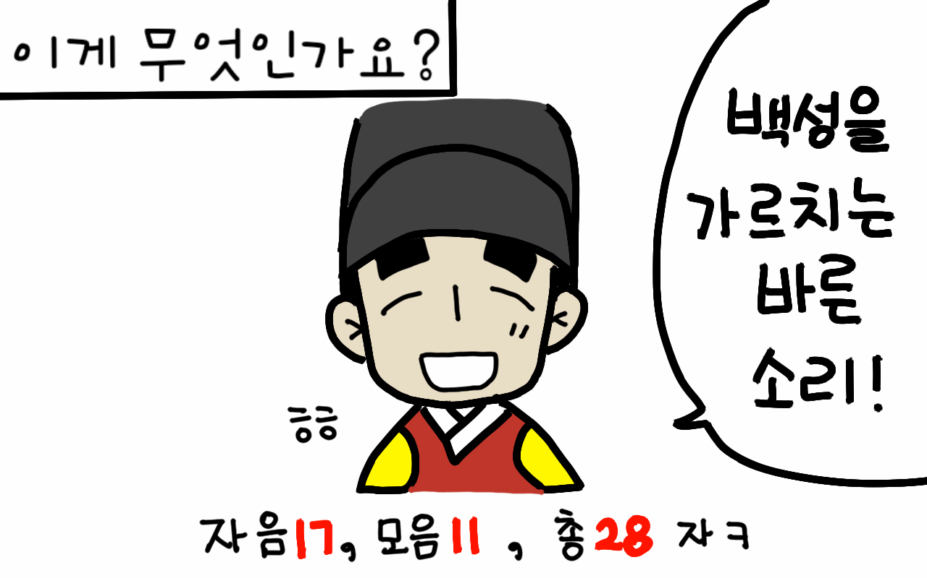
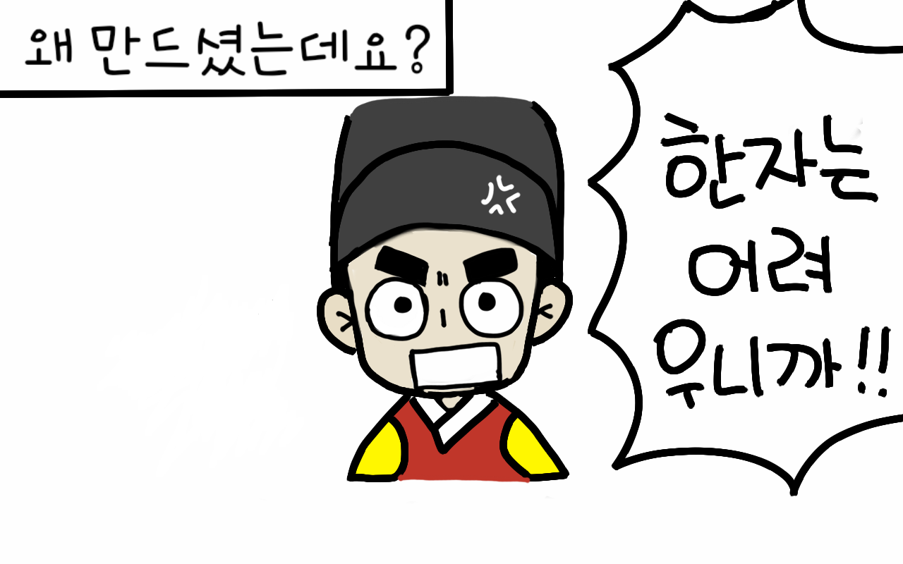
한자는 배우기가 어려워
많은 백성들은 글자를 몰랐음
Notes:
Until 훈민정음 was invented, Chinese characters were borrowed and used, but the people could not read and write because they could not study Chinese characters. 세종대왕, felt pity and created the scientific letters, 훈민정음 to teach the people.

Slide 6
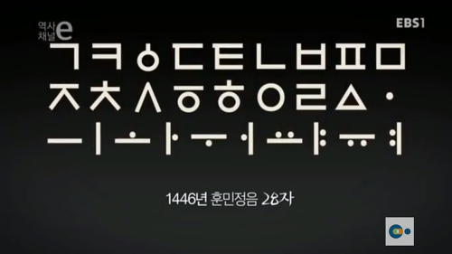
훈민정음이 처음 만들어졌을 때의 모양
Notes:
This is 훈민정음, when it was first created.

Slide 7
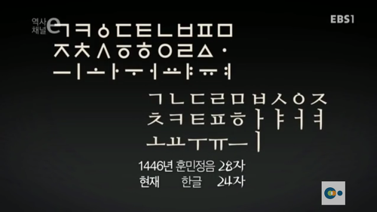
훈민정음 28자
현재 한글 24자
Notes:
훈민정음 had 28 characters, and now 한글 has 24 characters.

Slide 8
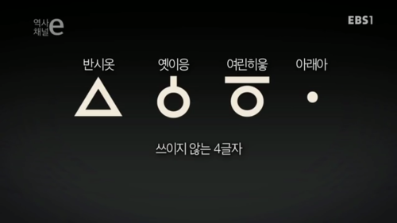
Notes:
These four letters are not currently used.

Slide 9
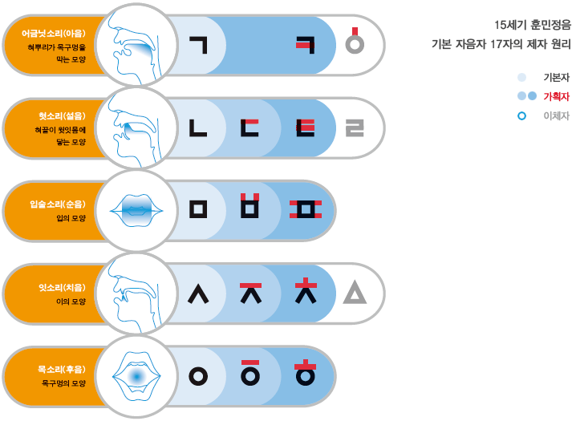
훈민정음
자음의 원리
Notes:
This is how the consonants of 훈민정음 were created. It was made, based on the shape of a person's mouth and how sound is made.

Slide 10

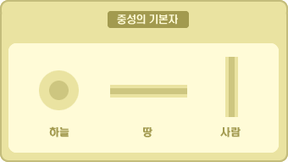
훈민정음
모음의 원리
Notes:
This is how the vowels of 훈민정음 were created. The dot represents the sky, the horizontal line represents the earth, and the vertical line represents human beings. The vowels are representations of the world.

Slide 11
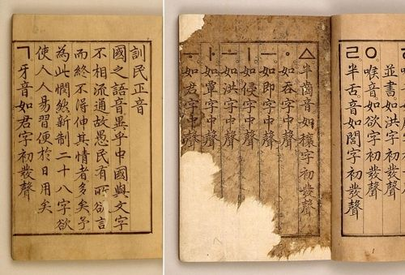
훈민정음 해례본
(Explanation and Examples)
Notes:
This photo is 훈민정음 해례본. This book explains in detail, the principles, process, and examples of the 28 훈민정음 characters.

Slide 12
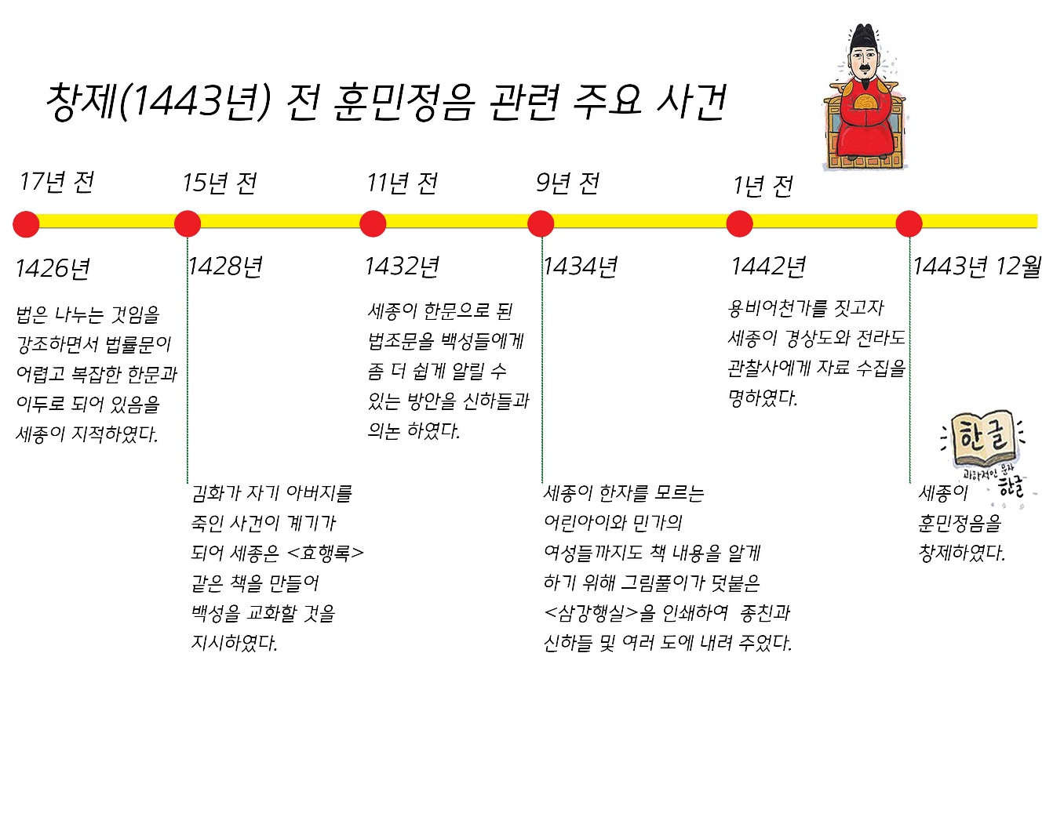
Notes:
These are the major events that led to the creation of 훈민정음. 세종대왕 thought that the people should also know the law. But, since it was written in difficult Chinese characters, it was difficult for people to understand. He kept thinking about how to educate the people. There was an incident where a man named 김화 killed his father, and with this incident, 세종대왕 wanted to make a book called <효행록> to teach the people. He also made a book called <삼강행실도> about the laws and ethics that people should follow. This book includes pictures so that even young children could understand.

Slide 13
한글날 (Hangul Day)
10월 9일 (국경일 – National Holiday)
훈민정음이 반포(proclamation)된 날
1945년 8월 15일 광복이 된 후부터 매년 기념식(Ceremony)을 하고 있음
Notes:
October 9th is 한글날,Korean Alphabet Day, a national holiday. It is the day that 훈민정음 was promulgated, and it has been commemorated every year since liberation on August 15, 1945.

Slide 14
유네스코 세종 문해상
(UNESCO King Sejong Literacy Prize)
문맹(illiteracy)를 없애기 위해서 노력한 단체에게 매년 9월 8일에 상을 줌
1989년에 제정되어 1990년부터 시상을 하기 시작하였음
Notes:
UNESCO has a King Sejong Literacy Prize, which is given to a group for their efforts to eradicate illiteracy. It was established in 1989 and has been awarded since 1990.

Slide 15
세종대왕의 리더십
Notes:
Let's learn about the leadership of 세종대왕.

Slide 16
애민정신
(백성을 사랑하는 마음)
소통의 리더십
백성을 위한 정책
Notes:
세종대왕 left many achievements for the people, 애민 정신. And instead of doing it arbitrarily, he showed leadership through his communication and love.

Slide 17
세종대왕의 리더십
안티사랑
Tolerance
마음의 균형
Balanced perspective
자기 절제
Self-control
아낌과 위함
Caring
자기 적합화
Selection of fit people
Notes:
Let’s clarify the leadership of 세종대왕. Tolerance, balanced perspective, self-control, caring, and unbiased selection of fit people

Slide 18
세종대왕의 리더십
자기 계발
Self-improvement
전문성 추구
Professionalism
자기 변화
Self-development
자기 경계
Self-vigilance
공정성 확보
fairness
Notes:
Self-improvement, professionalism, Self-development, self-vigilance, and fairness

